Slide 1
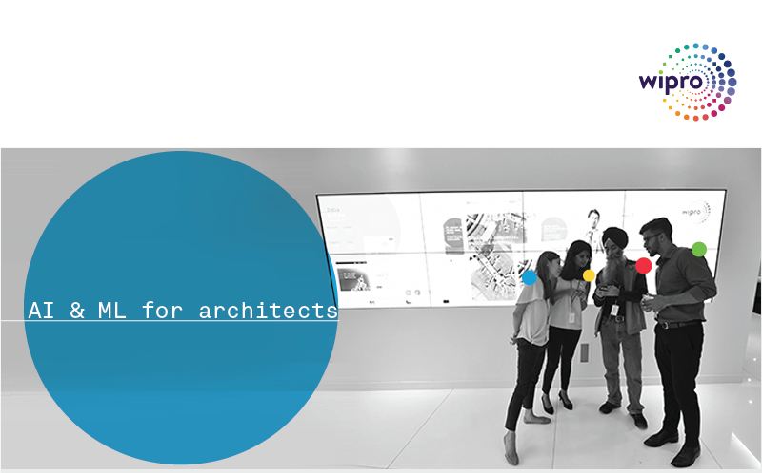
AI-ML-Techniques and Algorithms – Day 2 Gururajan Narasimhan Erode

Slide 2
Agenda for Day 2
Summary of our previous session
Overview of the different techniques of machine learning inside each type of learning
High level overview of the different algorithms present in each technique
Summary of the different structures in Deep learning with Neural networks
Examples for a few types of algorithms and their implementations

Slide 3
What is Machine Learning – Tom Mitchell - Review
The domain of machine learning is related to the question of how to build computer programs that by themselves (automatically) improve or LEARN from experience.
“A computer program is said to learn from experience E with respect to some class of tasks T and performance measure P if its performance at tasks in T, as measured by P, improves with experience E. …”
– Tom Mitchell
Tom M. Mitchell provided a widely quoted and more formal definition of the algorithms studied in the machine learning field. (The above definition and it is attributed to Tom Mitchell)
The important word here is Learning
What do we mean by the phrase “ I am Learning” ?
The ability to comprehend and improve my work based on experience

Slide 4
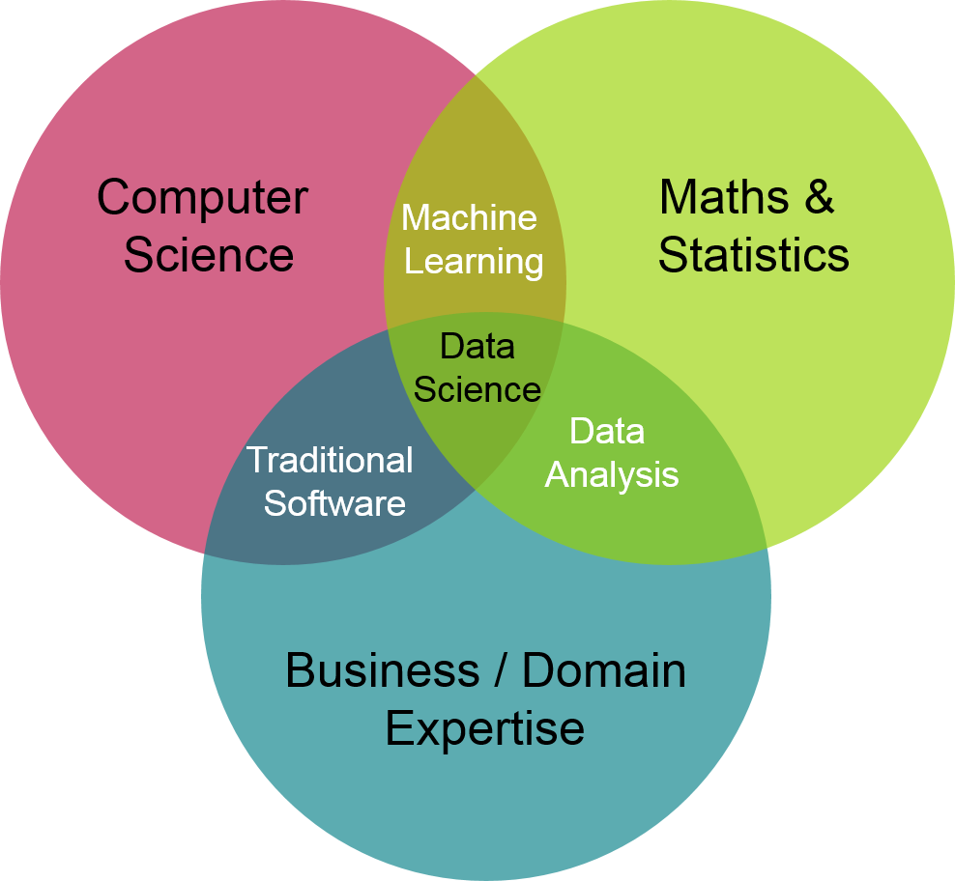
Machine Learning and Related Fields – Review
Picture credit: https://ion.icaew.com/itcounts/b/weblog/posts/theaccountinganddatascienceworldsmeet

Slide 5
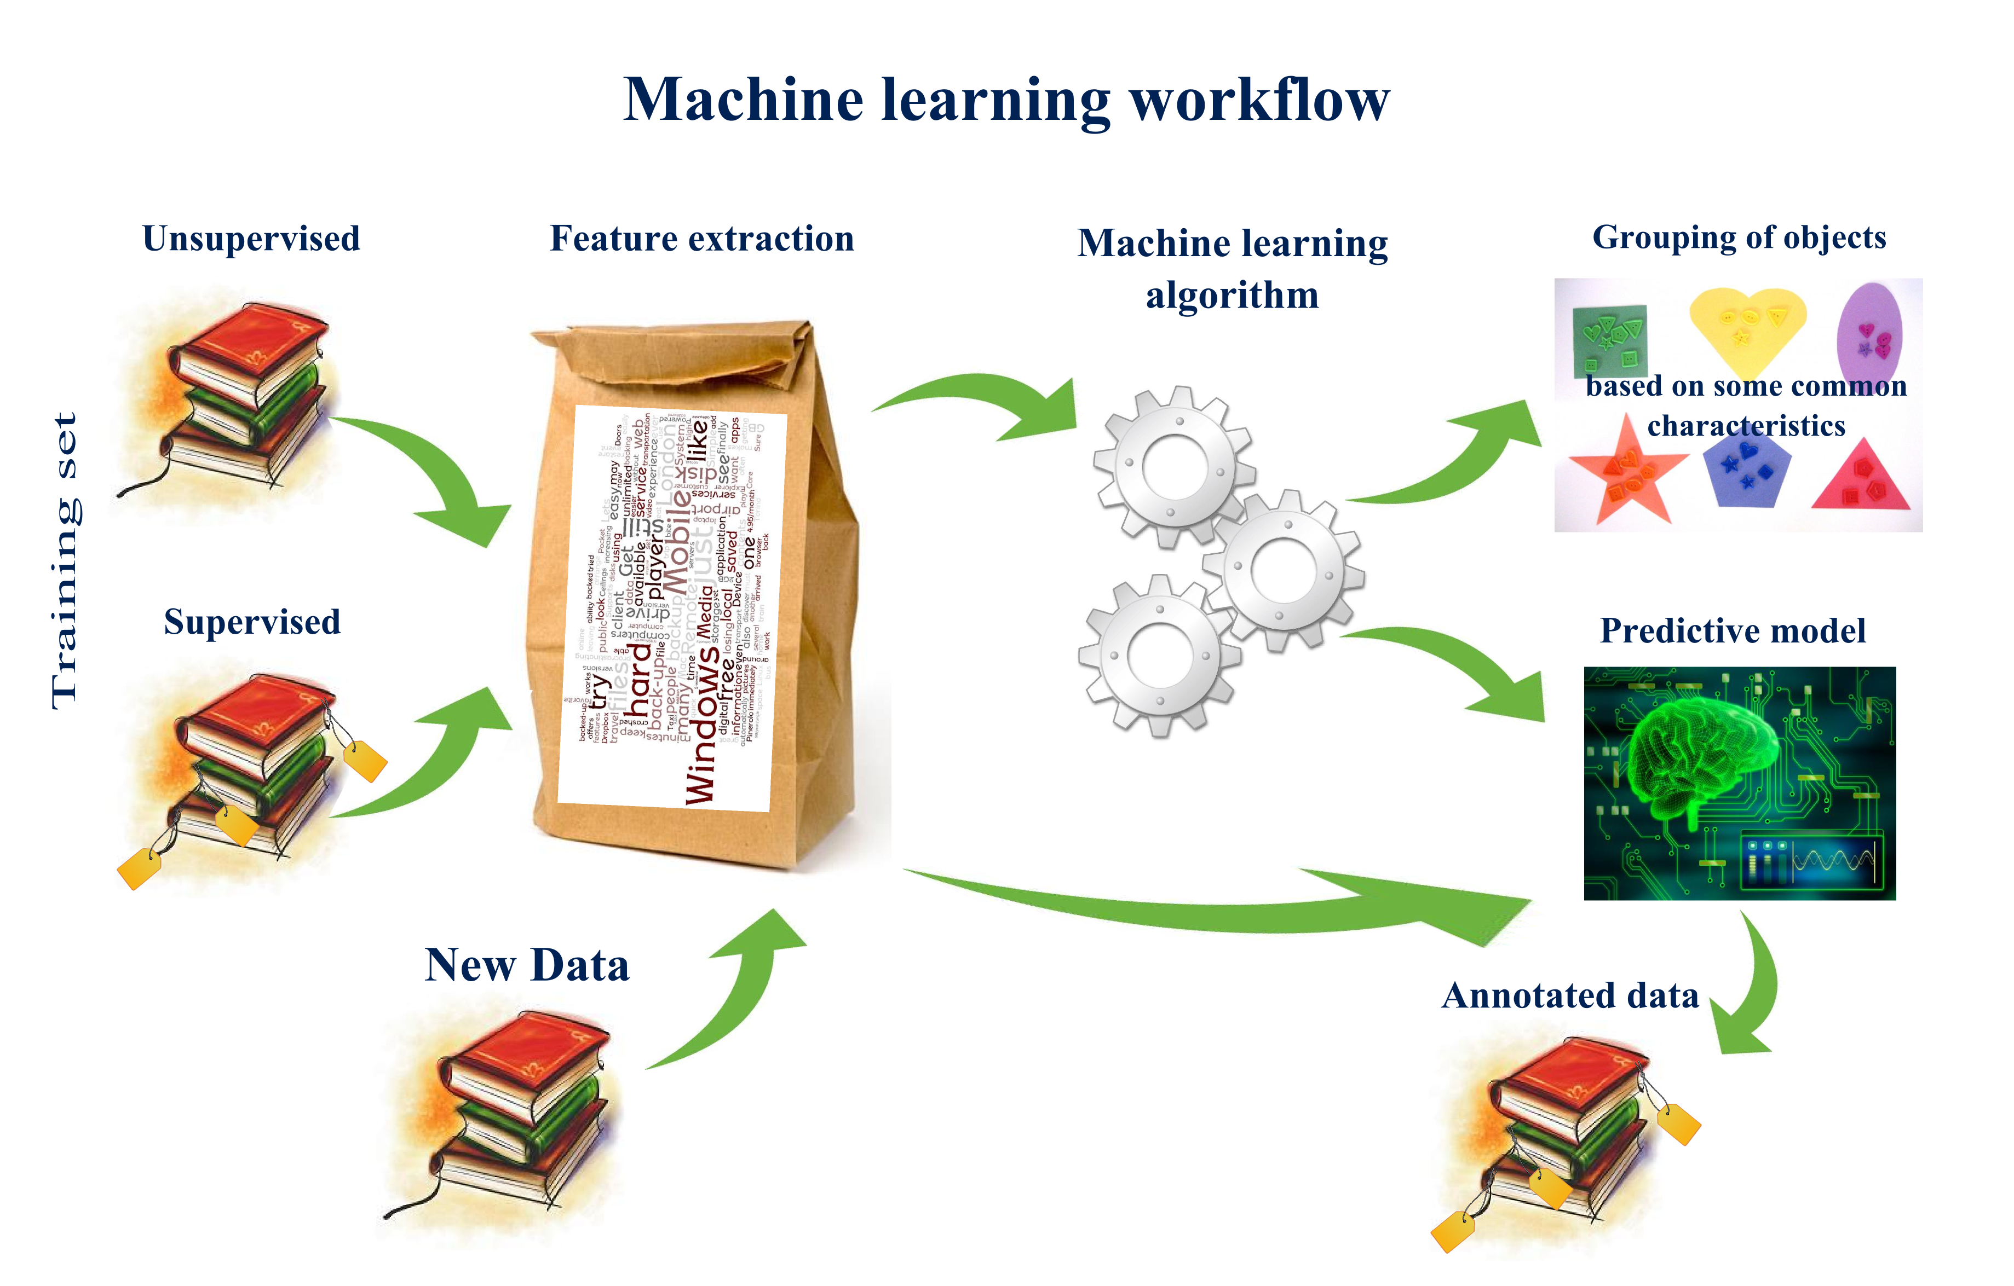
Review
Picture credit: http://nkonst.com/machine-learning-explained-simple-words/

Slide 6
Types of Models
Parametric Vs Non-Parametric Model
Generative Vs Discriminative Model
Linear (GLM) Vs Non-linear Models
Probabilistic model, Bayesian model
Markov model

Slide 7
Machine Learning Techniques – a comparison with humans
What humans do | Name of that technique in Machine Learning
Predict the class of data | Classification or Categorization
Predict a numerical value, continuously varying value | Regression
Group items or products or customers to different meaningful groups | Clustering
Show similar items or products | Recommendation
Associate a new item with already selected items | Association Rule Mining
Analyze and extract knowledge from chronological data | Time Series Analysis
Choose the most important features | Dimensionality Reduction

Slide 8
Machine Learning Techniques – a comparison with humans
What humans do | What is the that technique in Machine Learning
Fit an appropriate distribution for the given data to gather density and peak information | Density estimation
Combine many methods to get a best result | Ensemble learning
Find the odd man out in the given data | Outlier detection or Novelty detection or Anomaly detection
Simulate the way the brain works and find a solution to a problem | Neural networks and deep learning
Top 10 movies, Top 10 songs, Top 10 stocks to pick, Top 10 colleges to study | Ranking
Learn from criticism and praise | Reinforcement Learning
Understand how the genes retain and keep information and improvise | Genetic Algorithms

Slide 9
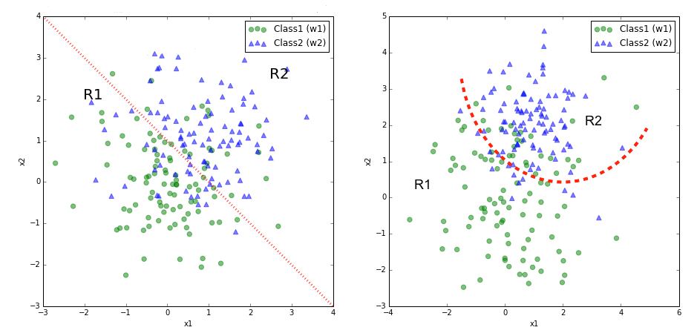
Classification examples
Finding the type of a flower
Finding if a person has a chance of getting diabetes or not
Classifying if a currency note is fake or real (fake currency detection)
Finding if a person will repay the loan or will default (also called credit risk assessment)
Finding the name of the author among the given 5 or 6 writers
Classifying the words as different parts of speech (POS)
Classifying the sentiment in the given review or sentence from 1 to 5

Slide 10

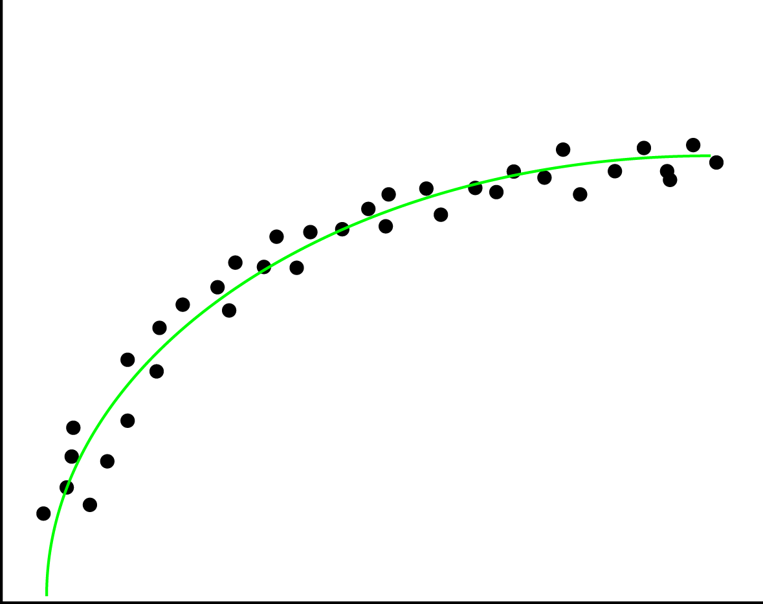
Picture credit: https://en.wikipedia.org/wiki/Linear_regression
Regression examples
Predicting the price of a house in a given area
Predicting the CGPA of a student from the given data
Predicting the revenue of the company based on the money spent on advertising
Predicting the wind speed, temperature and humidity tomorrow based on weather data so far
Predicting the fuel costs for the next five years for the airlines given the consumption pattern
Finding if a person will repay the loan or will default
Prediction of the energy demand in the district, state and country based on consumption patterns
Picture credit: https://xyclade.github.io/MachineLearning/

Slide 11
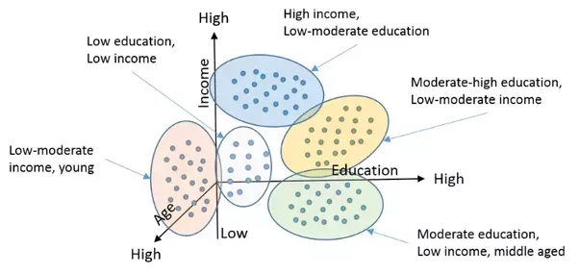
Clustering examples
Grouping a set of objects in such a way that objects in the same group are more similar to each other than to those in other groups
Grouping the customers in the retail domain for better targeting
Finding if a person has a chance of getting diabetes or not
Classifying if a currency note is fake or real (fake currency detection)
Finding if a person will repay the loan or will default (also called credit risk assessment)
Picture credit: https://www.quora.com/What-is-the-difference-between-Clustering-and-Classification-in-Machine-Learning

Slide 12
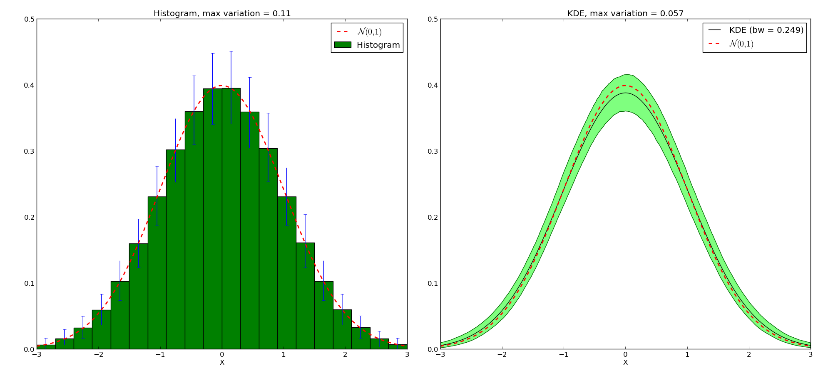
Density Estimation examples
Picture credit: http://pyqt-fit.readthedocs.io/en/latest/KDE_tut.html
Finding out the life expectancy in the population data
Finding the age group to target for insurance offerings in the given population
Pathological findings in the country given the population distribution

Slide 13
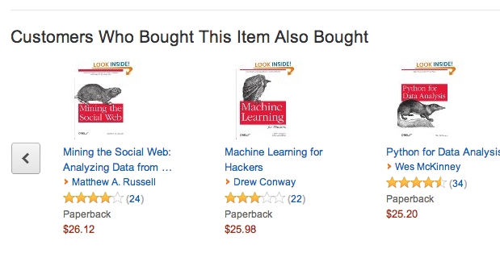
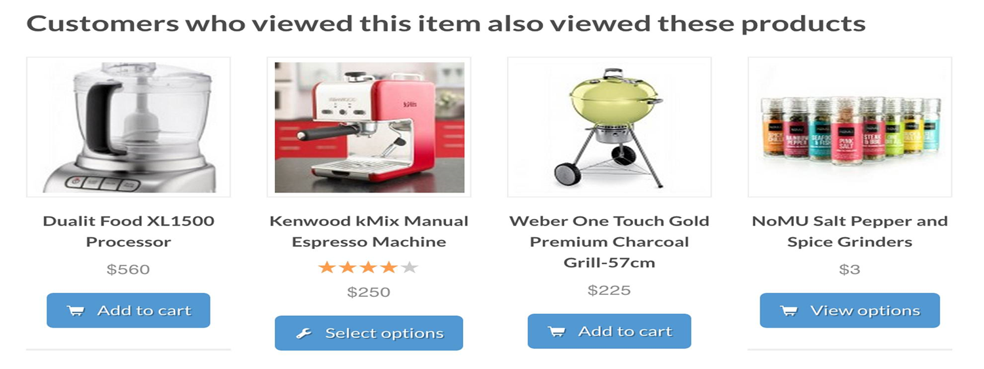
Recommendation examples
Recommending a product for online buyers
Recommending books online
Movie recommendation for users on Netflix
Finding if a person will repay the loan or will default (also called credit risk assessment)

Slide 14
Classification algorithms
Clustering algorithms
KNN – K Nearest Neighbors
Naïve Bayes
Bayesian Networks
Perceptron
Support Vector Machines (SVM)
Decision Trees
Random Forests
Deep learning based (CNN based) classification
Logistic Regression
K – Means
Fuzzy K-Means
Mean Shift
DBSCAN
OPTICS
Hierarchical Clustering
BIRCH (Balanced Iterative Reducing and Clustering using Hierarchies)

Slide 15
KNN Classification
Loan$
Age

Slide 16
KNN Classification – Distance
Age | Loan | Default | Distance
25 | $40,000 | N | 102000
35 | $60,000 | N | 82000
45 | $80,000 | N | 62000
20 | $20,000 | N | 122000
35 | $120,000 | N | 22000
52 | $18,000 | N | 124000
23 | $95,000 | Y | 47000
40 | $62,000 | Y | 80000
60 | $100,000 | Y | 42000
48 | $220,000 | Y | 78000
33 | $150,000 | Y | 8000
48 | $142,000 | ?
Euclidean Distance

Slide 17
Regression algorithms
Simple linear regression or uni-variate linear regression
multiple linear regression or multi-variate linear regression
logistic regression (used in classifcation)
polynomial linear regression
nonlinear regression
least squares regression
gradient descent algorithm
Kernel based regresstion
Types of gradient descent algorithms for solving regression problems
batch gradient descent
stochastic gradient descent
normal equation for solving regression problems
Types of regularization technique used in regression
1. LASSO regression (Least Absolute Shrinkage and Selection Operator)
2. ridge regression
3. elastic net

Slide 18
Recommender algorithms
Recommendation Systems
Content based filtering technique
Collaborative filtering technique
Hybrid filtering technique
Model based filtering technique
Memory based filtering technique
Clustering techniques
Association techniques
Bayesian networks
Deep learning based
User based
Item based

Slide 19
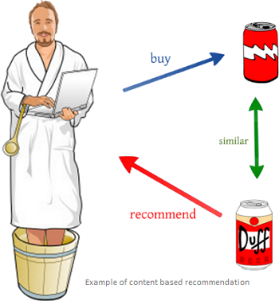
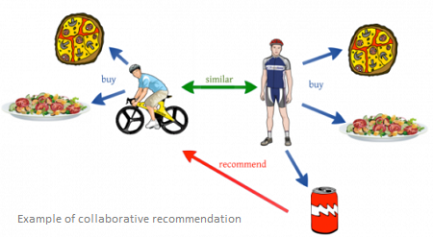
Picture credit: https://www.quora.com/What-is-the-difference-between-content-based-filtering-and-collaborative-filtering

Slide 20
Association rule mining algorithms
FP Growth – Frequent Pattern Mining
Apriori – (lift, confidence and support)
ECLAT – Equivalence Class Transformation
Market basket analysis

Slide 21
Time Series Analysis methods
Simple Moving Average (SMA)
Exponential Smoothing (SES)
Autoregressive Integration Moving Average (ARIMA)
Neural Network (NN)
Croston

Slide 22
Dimensionality Reduction techniques
Principal Component Analysis (PCA)
Factor Analysis
Canonical Component Analysis (CCA)
Factor Analysis
Independent Component Analysis (ICA)
Linear Discriminant Analysis (LDA)
Non-negative matrix factorization
T-distributed stochastic neighbour embedding

Slide 23
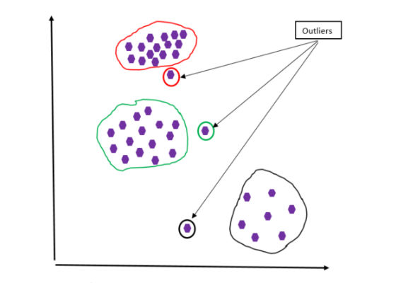
Outlier detection, novelty detection or anomaly detection techniques
Density based techniques
Cluster analysis based outlier detection
Fuzzy logic based outlier detection techniques
Subspace and correlation based outlier detection for high dimensional data
Plotting (visual techniques)

Slide 24
Applications of Outlier Detection
Credit card fraud detection and statistical methods
Fraudulent insurance claims in hospitals and fraudulent life insurance claims
Activity monitoring—the detection of fraud of mobile phones and proximity-based methods
Detection of network security breach – finding something unusual in traffic
Intrusion detection and density-based methods
Medical Diagnosis
Monitoring the performance of network-based and classification-based methods
Detecting novelty in text, topic detection, and mining contextual outliers
Video surveillance and unusual footage in it

Slide 25
Types of Ensemble Learning
Bagging (bootstrap aggregating)
Adaboost
Boosting
Stacking
Random forest

Slide 26
Density estimation techniques
Expectation maximization
Parzen windows
Vector quantization
Rescaled histogram (most popular estimation technique)
Kernel density estimation
Many clustering techniques

Slide 27
Reinforcement Learning Techniques
SARSA – State Action Reward State Action
Q-Learning – ‘Q’ means Quality – quality of an action in a given state
DQN – Deep Q Network
DDPG – Deep Deterministic Policy Gradient

Slide 28
Different neural networks and deep learning structures
back propagation algorithm
forward propagation algorithm
perceptron
Deep Neural Networks - Multi Layer Perceptron
Unsupervised Pretrained Networks (UPNs)
Convolutional Neural Networks (CNNs)
Recursive Neural Networks
Recurrent Neural Networks (RNNs)
Long Short Term Memory Networks - LSTMs
Types of Autoencoders:
1. Denoising autoencoder
2. Sparse autoencoder
3. Variational autoencoder (VAE)
4. Contractive autoencoder (CAE)
Generative Adversarial Networks - GANs
Deep Belief Networks – DBNs
Energy Based Models
Boltzmann Machines
Restricted Boltzmann Machines
Self Organizing Map

Slide 29
Genetic Algorithms working
Population of
individuals or alternative
(feasible) solutions
Next generation
of
individuals
Evaluate individuals
on their fitness
Differential Reproduction
Select individuals
based on fitness
for subsequent mating
Arbitrarily change
some characteristic
Genetic Variation
Select individuals
& exchange charac-
teristics to create
new individuals
Heredity
Mating pool of
“fitter”
individuals

Slide 30
Genetic Algorithms - Applications
Optimizing schedules -
Optimizing portfolios – (stock market and in organizations)
Analyzing protein structure
Optimizing engineering processes – (shop floor and process planning)
Route optimization
Optimum layout – VLSI design layout, city area layout
Optimal packaging
Engineering component design, equipment design

Slide 31
Top 10 Algorithms
Naïve Bayes Classifier Algorithm
K Means Clustering Algorithm
Support Vector Machine Algorithm
Apriori Algorithm
Linear Regression
Logistic Regression
Artificial Neural Networks
Random Forests
Decision Trees
Nearest Neighbours

Slide 32
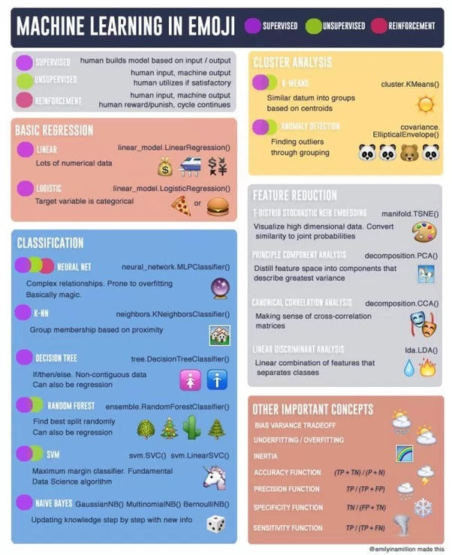
Picture credit is given to: please see -> https://www.datasciencecentral.com/profiles/blogs/the-making-of-a-cheatsheet-emoji-edition

Slide 33
Machine Learning and Data Mining frameworks
Numpy – Jim Hugunin, Travis Oliphant, 2005, python
Scipy - python
ScikitLearn – from google – 2007 – Google summer of code project, - python
Jupyter Notebook, - python
Matplotlib - python
Statsmodels - python
Pandas – 2005, 2006 - python
Rstudio – for R language
SAS (Statistical Analysis System – 50 years old, in C)
Rapid Miner
SPSS (Statistical Package for Social Sciences – from IBM – 50 years old, written in Java)
Weka – Waikato Environment for Knowledge Analysis, Java, University of Waikato, Newzealand
KNIME (Konstanz Information Miner from Germany, Java, 2006)
Tensor flow, python and C++
Keras, python and C++
Microsoft CNTK, C++, Visual C++
Amazon ML
Editors and IDEs
Rstudio , Pycharm, Vim, Emacs
Languages, Visual Studio
Python, R, C++, Scala, Lua & Clojure

Slide 34
Natural language processing and computer vision frameworks
Natural Language Processing
NLTK – Natual Language Processing Toolkit
Textblob
Open NLP
Stanford NLP
GATE – General Architecture for Text Engineering
MATLAB
Amazon lex
Computer Vision
Deep dream - google
Open CV
MATLAB
Bing Vision - microsoft
Amazon Rekognition - amazon

Slide 35
Robotics and Speech Recognition frameworks
Robotics
Robotics Software Development frameworks
Robot Mind
Fawkes
Robot Operating System
Robotics Development Studio - - microsoft
Speech Recognition
Bing speech API – from microsoft
Amazon – poly API
Google speech recognition API
Simon
Kaldi
Julius

Slide 36
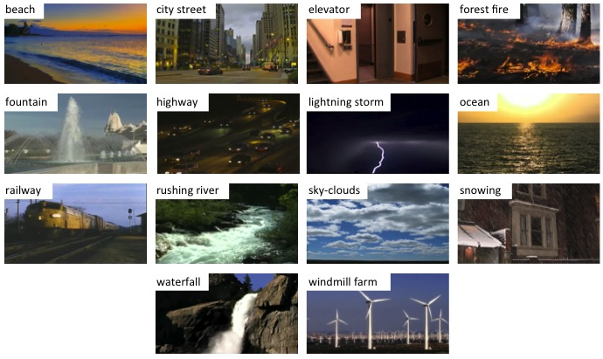
Scenes classification:
picture credit: http://vision.eecs.yorku.ca/research/dynamic-scenes.shtml

Slide 37
Demonstrations
https://www.youtube.com/watch?v=kkha3sPoU70
C:\Users\Gururaj\Desktop\Demostrations\Speed Sign Recognition by Convolutional Neural Networks.mp4
https://www.youtube.com/watch?v=UrWAeukkLdk
C:\Users\Gururaj\Desktop\Demostrations\Speed Sign Recognition by Convolutional Neural Networks 2.mp4
C:\Users\Gururaj\Desktop\Demostrations\Volkswagen Tiguan Automatic Parking Demonstration.mp4
https://www.youtube.com/watch?v=_qah8oIzCwk
..\Demostrations\Drone Autonomously Avoiding Obstacles at 30 MPH.mp4
https://www.youtube.com/watch?v=0FW99AQmMc8
..\Demostrations\Visually-Indicated Sounds.mp4

Slide 38
Neural networks Why study neural networks and deep learning? We already so many techniques in conventional machine learning?
Whenever you have a problem that is difficult to solve look
towards nature - Albert Einstein

Slide 39
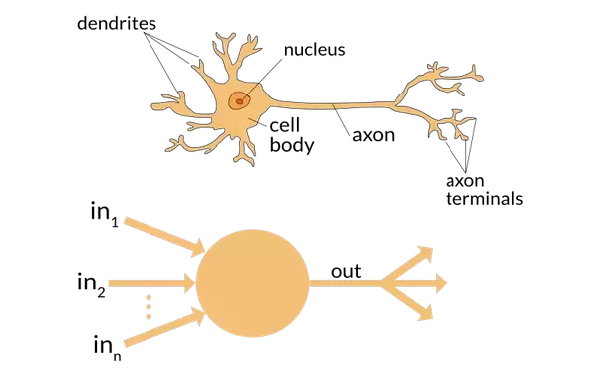

Slide 40
Neurons
Neurons are special brain cells that transmit signals between themselves and also from and to the brain at up to 200 mph.
The neuron contains a cell body (or soma) with dendrites branching (signal receivers) and a there is a projection known as an axon, which conducts the signal.
There are approximately 50 to 70 trillion cells in an adult humans body. A neuron is a special type of brain cell.
Out of the total 70 trillion cells, there are approximately 85 billion neurons (special cells) in our brain

Slide 41
Neurons
The signals from the auditory cortex, visual cortex and sensory cortex reach these neurons via the nerves that conduct these signals
Neurons have the wonderful capacity to collect and transmit electrochemical signals – we can imagine them as gates and the inputs and outputs of gates
Neurons share the same characteristics and have the same makeup as other cells, but the electrochemical aspect lets them transmit signals over long distances (up to several feet or a few meters) and send messages to each other.

Slide 42
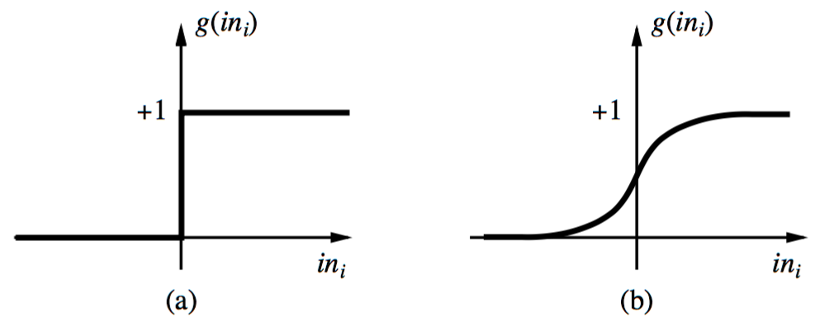
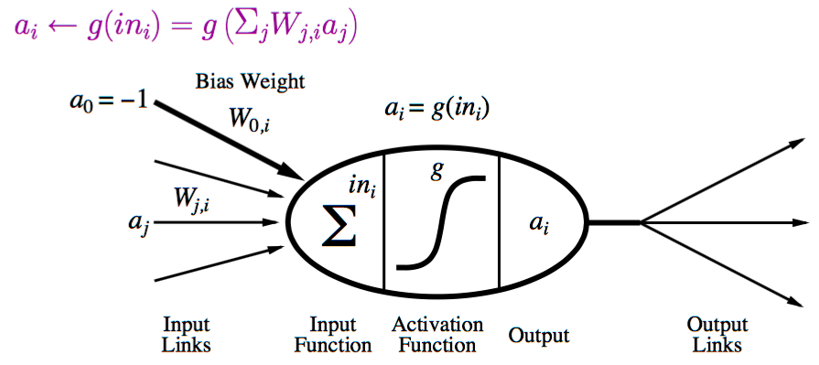
Neural Network: A Neuron
A neuron is a computational unit in the neural network that exchanges messages with each other.
Possible activation functions:
Step function/threshold function
Sigmoid function (a.k.a, logistic function)

Slide 43
Artificial Neural Networks and Deep Learning
Artificial neural network (ANN) - A computational model that is based on the functions and structure of neurons in our brain. We provide Information through the input nodes of the network which goes through the network. This affects the structure of the ANN, in the sense the neural network changes - or learns based on the input we give and the outputs it produces
Using Artificial Neural Networks, we can find complex non-linear relationships between the input and output. We could create a model and patterns can be found in the data. So ANNs are in a way a non-linear statistical modeling paradigm
In this context we can see deep learning as a technique where we have two or more than two layers in the neural network (the layers are deep)

Slide 44
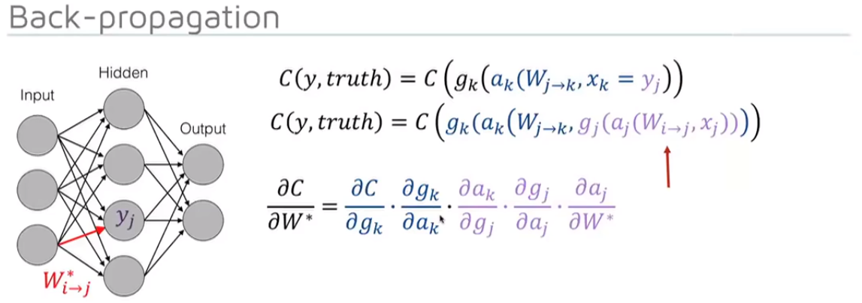
Feed forward Neural Network

Slide 45
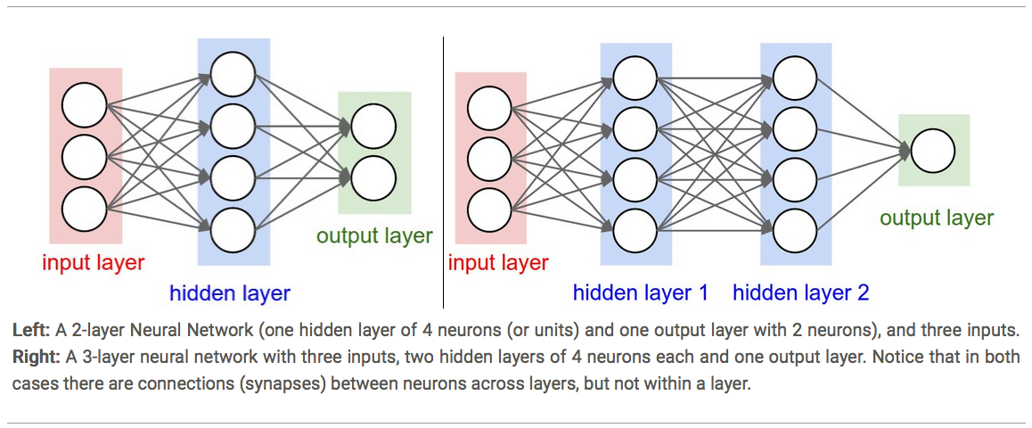
Picture credit: https://blog.liang2.tw/2015Talk-DeepLearn-CNN/?full#24

Slide 46
Convolutional Neural Network (CNN)
Convolutional Neural Networks are inspired by mammalian visual cortex.
The visual cortex contains a complex arrangement of cells, which are sensitive to small sub-regions of the visual field, called a receptive field. These cells act as local filters over the input space and are well-suited to exploit the strong spatially local correlation present in natural images.
Two basic cell types:
Simple cells respond maximally to specific edge-like patterns within their receptive field.
Complex cells have larger receptive fields and are locally invariant to the exact position of the pattern.

Slide 47
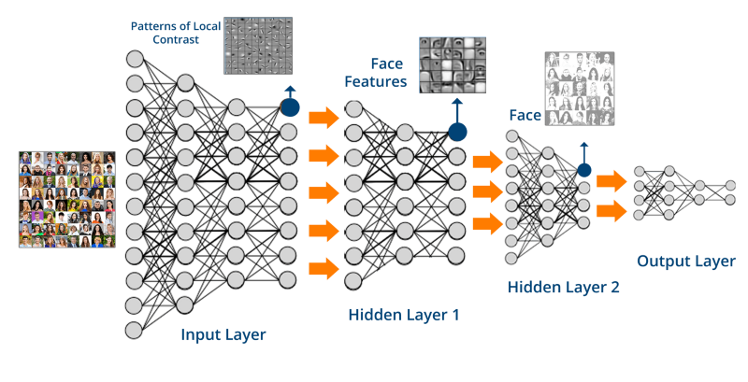
Picture credit: https://towardsdatascience.com/creating-a-movie-recommender-using-convolutional-neural-networks-be93e66464a7

Slide 48
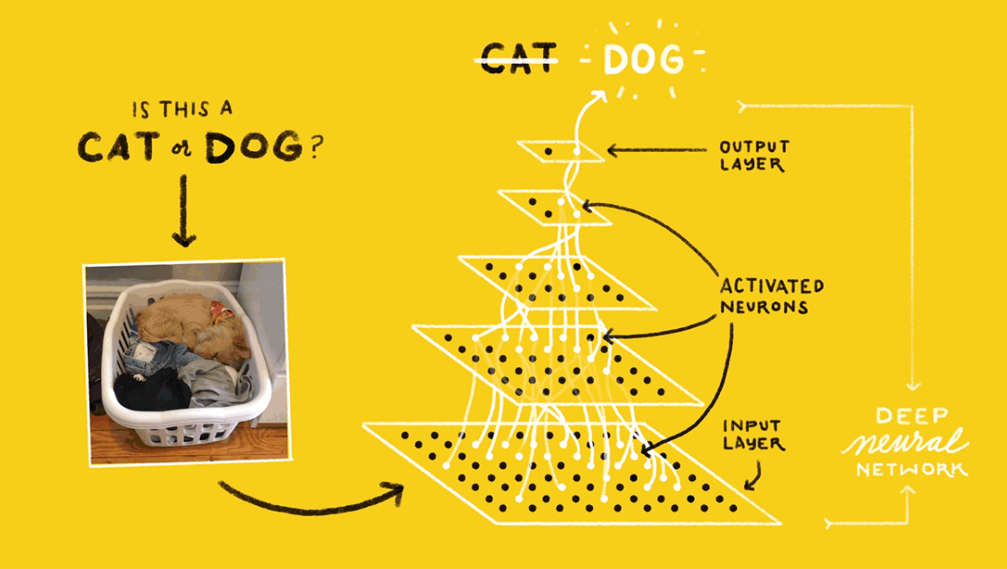
Picture credit: https://towardsdatascience.com/deep-learning-with-tensorflow-part-1-b19ce7803428

Slide 49
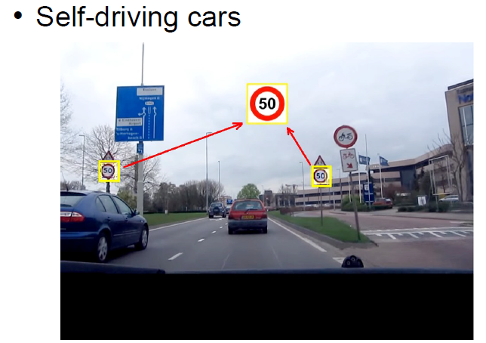
Speed sign detection in a moving car on a highway in day and at night
https://www.youtube.com/watch?v=kkha3sPoU70

Slide 50
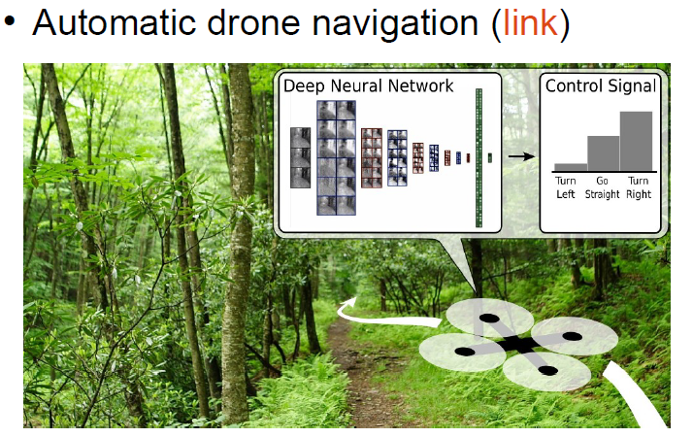
Automatic drone navigation - link
https://www.youtube.com/watch?v=_qah8oIzCwk
Digits recognition using CNN
https://cs.stanford.edu/people/karpathy/convnetjs/demo/mnist.html

Slide 51
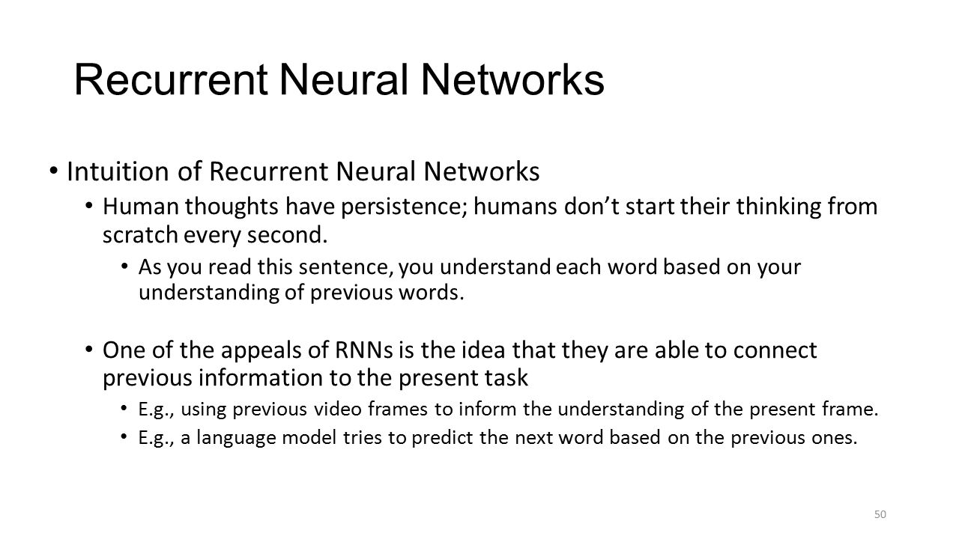

Slide 52
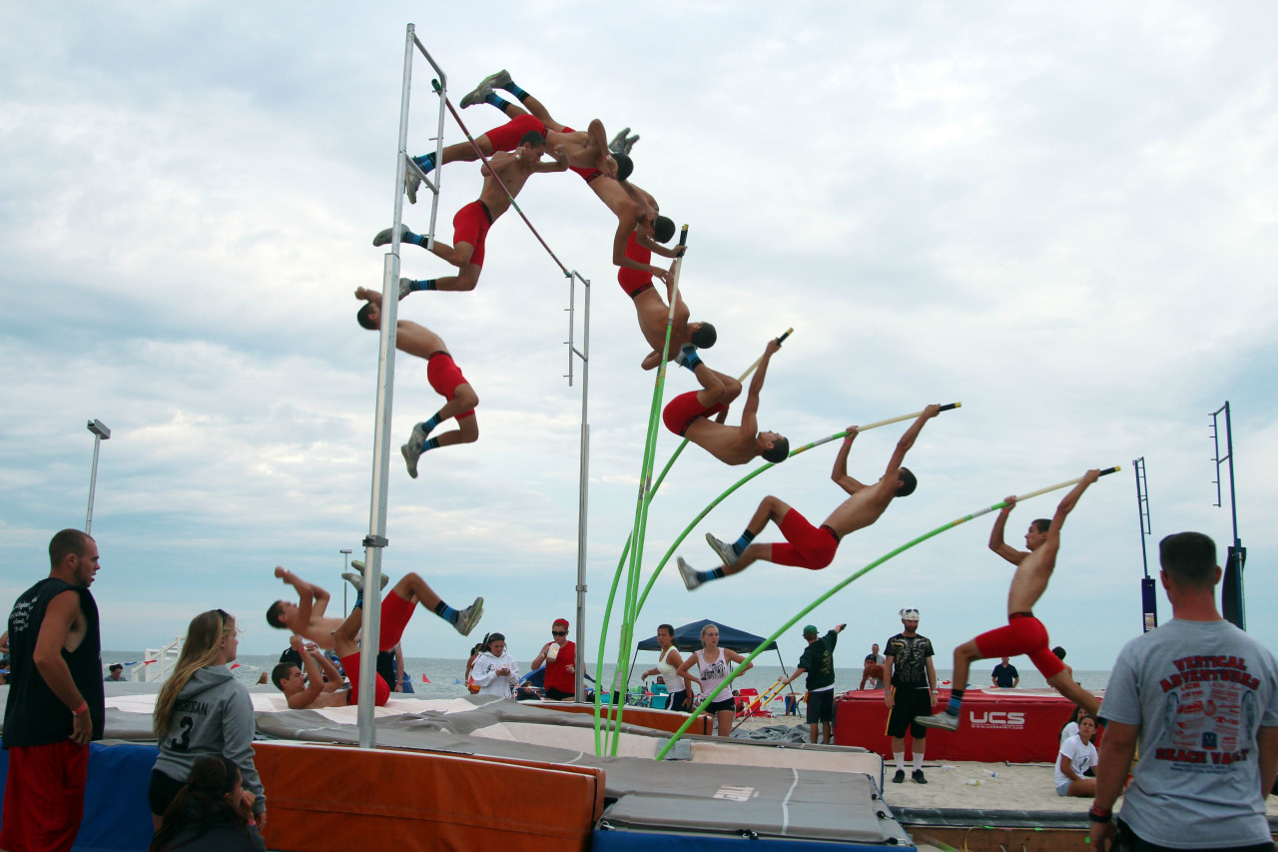
Recurrent Neural Networks – RNN –previous video frames used to understand the next one

Slide 53
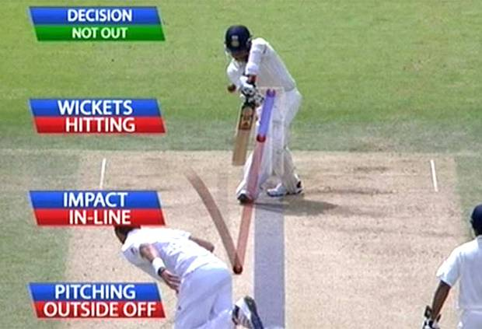
Recurrent Neural Networks – RNN – used in DRS – Decision Review System

Slide 54
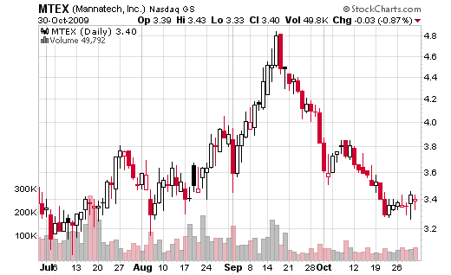
Recurrent Neural Networks in understanding stock prices

Slide 55
References
https://www.bistasolutions.com/resources/blogs/5-statistical-methods-for-forecasting-quantitative-time-series/
Machinelearningmastery.com

Slide 56
References
https://www.bistasolutions.com/resources/blogs/5-statistical-methods-for-forecasting-quantitative-time-series/
Machinelearningmastery.com

